Slide 1
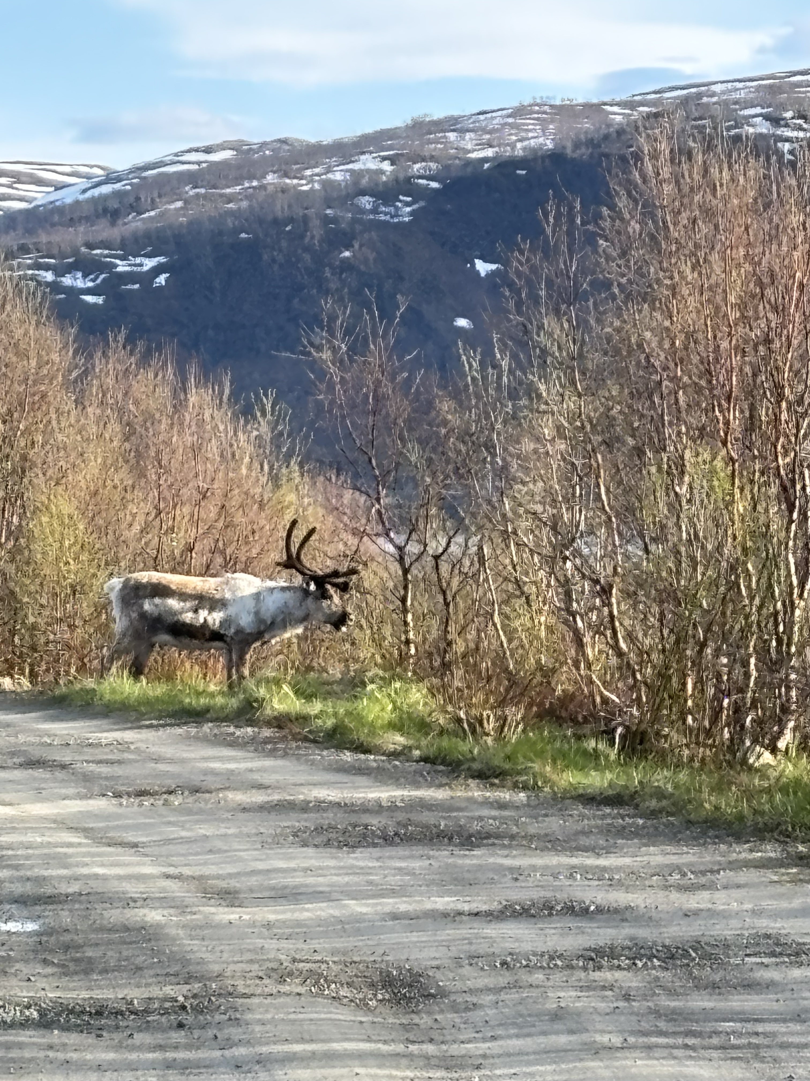
Czech emotions all over the map: a usage-based approach to grammar and meaning
Laura A. Janda, UiT
Dominika Kováříková, Charles University

Slide 2
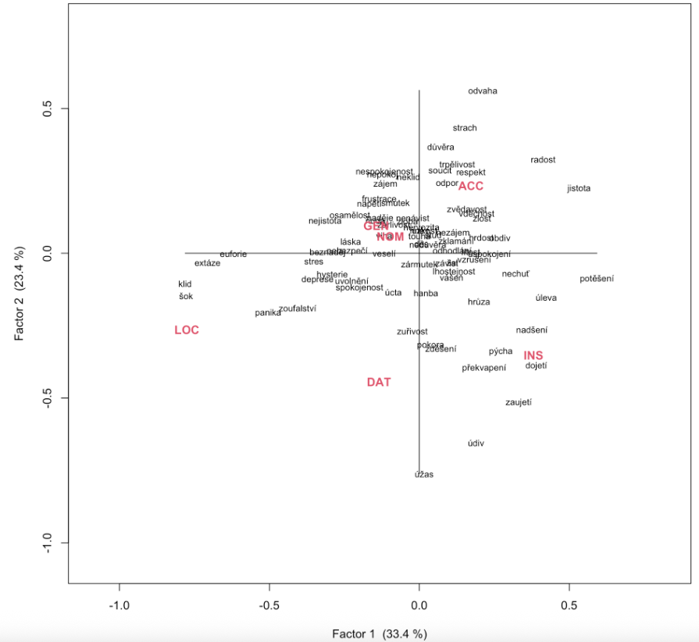
Sneak preview
metaphorical
possessions
Some words are strongly attracted to certain grammatical cases, where they serve as metaphorical possessions, containers, agents, or accessories
metaphoricalcontainers
metaphorical agents, accessories

Slide 3
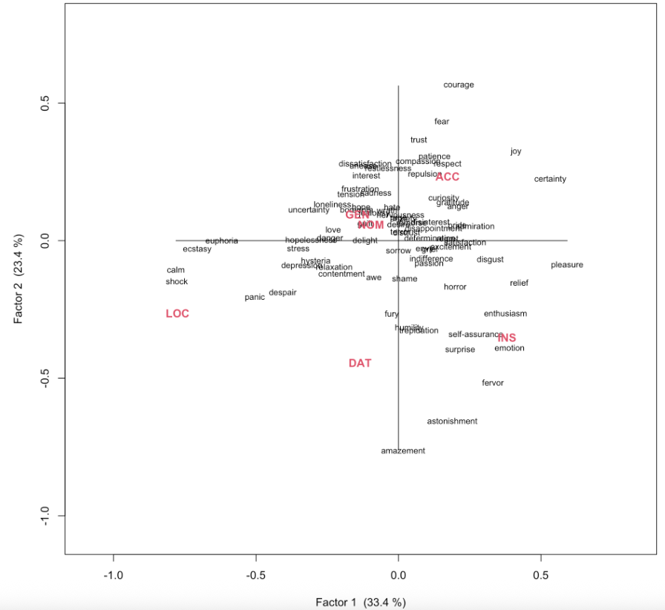
Sneak preview
metaphorical
possessions
(with English glosses)
Some words are strongly attracted to certain grammatical cases, where they serve as metaphorical possessions, containers, agents, or accessories
metaphoricalcontainers
metaphorical agents, accessories

Slide 4
Understanding Emotions Through Grammar
Overview
Lexical meaning and grammatical meaning as a continuum
Grammar supplements and differentiates meaning
Grammatical case and meaning
Classification of emotions
Grammatical profiles: vectors of distribution in corpus data
SMARTool, GramatiKat
Data and analysis of Czech emotion words
What does this buy us?
Theoretical contribution
Lexicography
Language pedagogy

Slide 5
Lexical meaning and grammatical meaning as a continuum

Slide 6
Theoretical grounding
“grammar is symbolic in nature … grammar and lexicon form a continuum”(Langacker 2008: 161)
cf. also Goldberg 1995 & 2006, Croft 2001, Fillmore’s FrameNet, etc., and see more citations in Boas 2010
Not a new idea, cf. Bühler (1982) and other earlier discussions of form-meaning relationship

Slide 7
Grammatical case and meaning

Slide 8
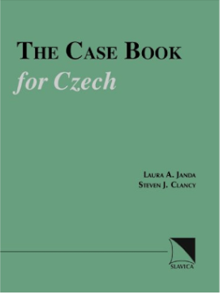
The Case Book for Czech (Janda & Clancy 2006)
Goal: explain the motive for all uses of the seven grammatical cases in Czech
“Case meaning takes as its point of departure the relationships that hold between physical objects placed or moving in space. These relationships can be metaphorically transferred to other domains such as time or social interactions”
case semantics are to some extent language-specific (no claim of universality)
cf. also Janda & Clancy 2002 The Case Book for Russian

Slide 9
Overview of the case meanings
For each case:
Schematic meaning
Abstract overall idea
Network of 1 to 4 meaning nodes
Structured polysemy: meanings are related to each other
Metaphorical and metonymic extensions, usually from space to other domains: time, purpose, etc.

Slide 10
Nominative
Nominative: Identification
NOMINATIVE: A NAME
Used to point out an item
The grammatical subject, the active agent in a situation
NOMINATIVE: AN IDENTITY
With verbs meaning ‘be’ as in ‘X is Y’ [Domovník není nepřítel ‘The janitor isn’t an enemy’], where “X” (janitor) is NOMINATIVE: A NAME as the grammatical subject, while “Y” (enemy) is NOMINATIVE: AN IDENTITY.

Slide 11
Genitive: Backgrounded with respect to something in proximity
Genitive
GENITIVE: A SOURCE
Point of departure specified by prepositions meaning ‘from’ (z, s, od…), verbs expressing withdrawal (stranit se ‘avoid’, bát se ‘be afraid of’…); extended metaphorically to time, cause, human relationships.
GENITIVE: A GOAL
Point of attainment specified by prepositions (do ‘up to, until’), verbs and adjectives expressing (mostly metaphorical) approach (dočkat se ‘wait for’, dotknout se ‘touch’…); extended metaphorically to time, purpose, states of being.
GENITIVE: A WHOLE
Part of a larger unit; ‘of’, possession; participant in a nominalized event (setkání dětí ‘meeting of children’); complex prepositional phrases; quantification (milión dolarů ‘a million dollars’); verbs of consumption (přejíst se knedlíků ‘eat too many dumplings’).
GENITIVE: A REFERENCE
Proximal landmark (u ‘by, at’ and other prepositions); temporal setting; preposition bez ‘without’

Slide 12
Dative: Capacity to interact with surroundings
Dative
DATIVE: A RECEIVER
indirect object (Jan dal mamince knihu ‘Jan gave his mother a book’), includes many verbs without an overt direct object, such as verbs of communication and payment.
DATIVE: AN EXPERIENCER
Expressions of harm, benefit, belonging to, enjoyment; experience of environment, emotions.
DATIVE: A COMPETITOR
With words expressing domination, matched competition or submission to a greater force; k ‘toward’ identifies a person or entity that exerts influence.

Slide 13
Accusative: Path toward a destination
Accusative
ACCUSATIVE: A DESTINATION
Direct object; path specified by prepositions (v ‘into’, na ‘onto’, za ‘beyond’, pod ‘under’…); metaphorical extensions to domains such as time, purpose, change of state.
ACCUSATIVE: A DIMENSION
Distance or size (ujet třicet kilometrů ‘ride thirty kilometers’), duration (spát celou noc ‘sleep the whole night’); prepositions specify path contours (skrz ‘through’, přes ‘across’).

Slide 14
Vocative: Call for attention
Vocative
VOCATIVE: A CALL
Let someone know that the speaker is talking to them rather than about them: Maminko a tatínku! ‘Mom and dad!’

Slide 15
Locative: Location
Locative
LOCATIVE: A PLACE
Locations in space or other domains specified by prepositions v ‘in’, na ‘on’, při ‘at’, o ‘about’, po ‘after’ (v Moskvě ‘in Moscow’, na stole ‘on the table’).

Slide 16
Instrumental: Peripheral conduit or attachment
Instrumental
INSTRUMENTAL: A MEANS
Conduit for an action (šli jsme lesem ‘we walked through the forest’); instrument that makes an action possible (řezat maso nožem ‘slice meat with a knife’); with verbs signifying control and evaluation (vládnout něčím ‘use something masterfully’); passive agent (Dopis napsán otcem ‘The letter was written by father’); facilitator in a sentence lacking a grammatical subject (Polilo ho horkem ‘A sensation of heat poured over him’).
INSTRUMENTAL: A LABEL
With verbs denoting being, becoming, and seeming to identify a category that something belongs to (Proč nejsem ctitelem Václava Klause ‘Why I am not an admirer of Václav Klaus’).
INSTRUMENTAL: AN ADJUNCT
Preposition s ‘with’ (Marie přišla s Janem ‘Marie came with Jan’).
INSTRUMENTAL: A LANDMARK
Prepositions nad ‘above’, pod ‘under’, před ‘in front of’, za ‘behind’, mezi ‘between’.

Slide 17
Classification of emotions

Slide 18
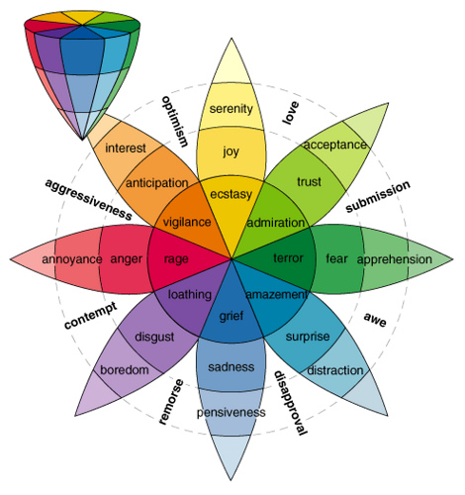
Plutchik’s Wheel of Emotions (1980)
[nouns]

Slide 19
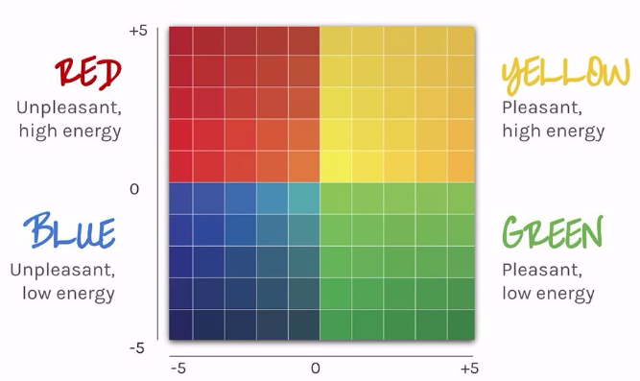
Brackett’s (2019) “mood meter”

Slide 20
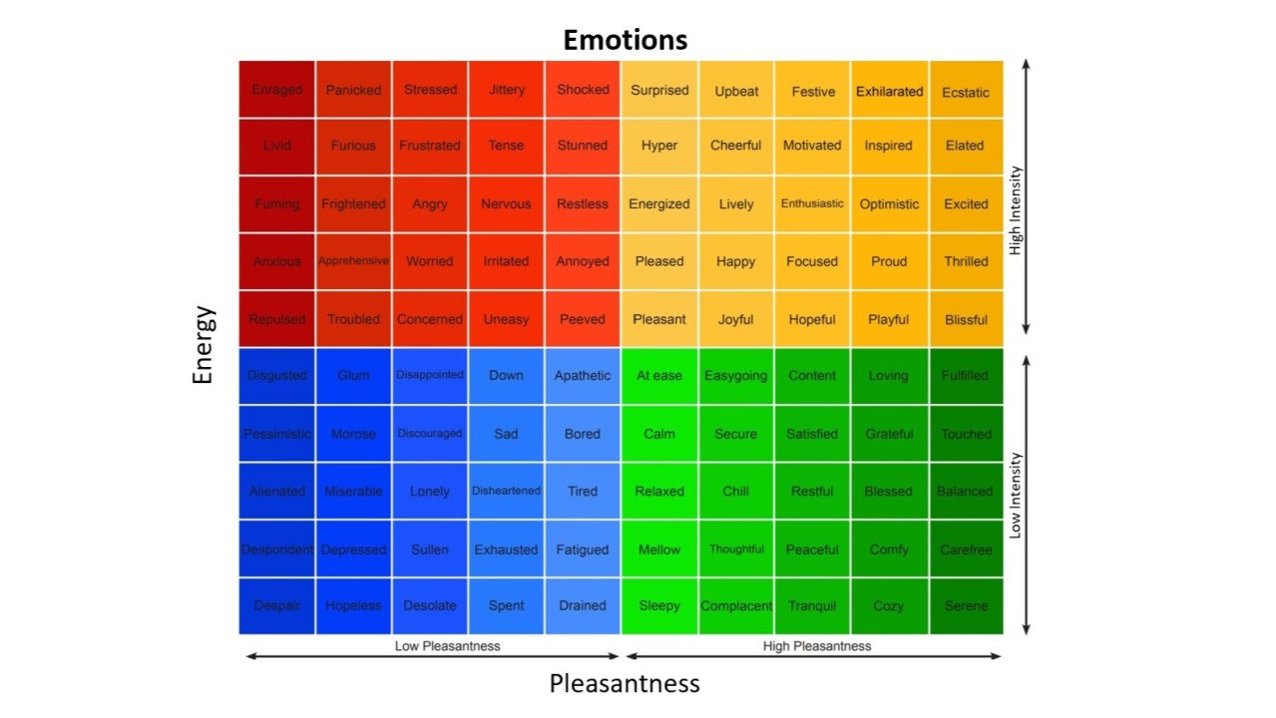
[adjectives]

Slide 21
Grammatical profiles: vectors of distribution in corpus data

Slide 22
Janda & Solovyev 2009: What constructional profiles reveal about synonymy: A case study of Russian words for SADNESS and HAPPINESS
Based on hand-coding of 500 example sentences for each word extracted from the Russian National Corpus and Biblioteka Maksima Mošova
“Constructional profiles” show the vectors of preposition + case constructions for Russian synonyms
‘sadness’: pečal’, toska, xandra, melanxolija, grust’, unynie
‘happiness’: naslaždenie, radost’, udovol’stvie, likovanie, vostorg

Slide 23
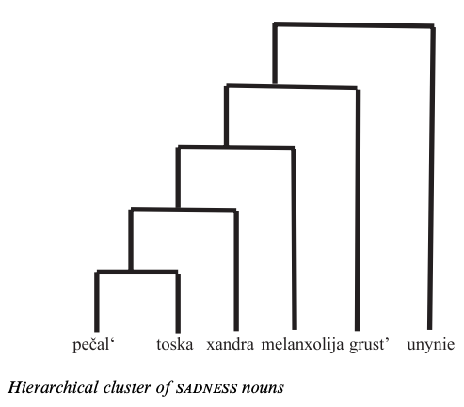
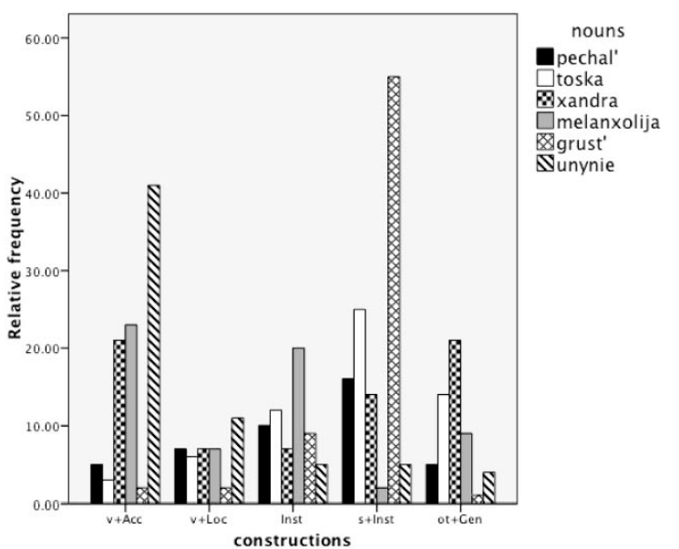
“We present the constructional profile, the relative frequencies of constructions a word appears in, as a possible measure of a word’s meaning.”

Slide 24
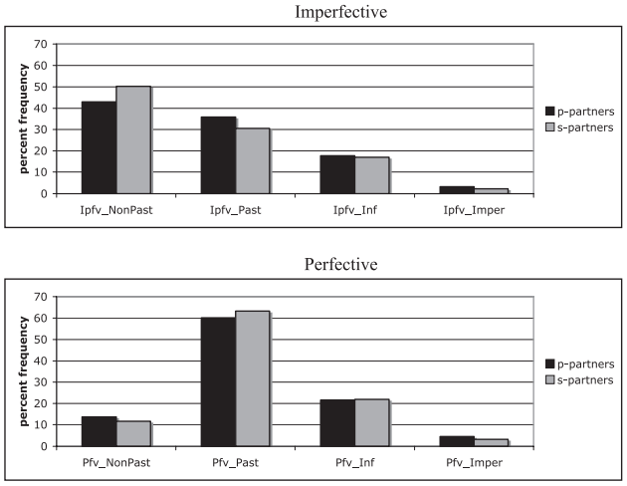
Janda & Lyashevskaya 2011: Grammatical profiles and the interaction of the lexicon with aspect, tense, and mood in Russian
Based on data in the Russian National Corpus
Differences between perfective and imperfective verbs are the same regardless of whether aspect is marked by prefixes or suffixes.
“Grammatical profiles make it possible to identify verbs that behave as outliers, presenting unusually large proportions of usage in parts of the paradigm.”

Slide 25
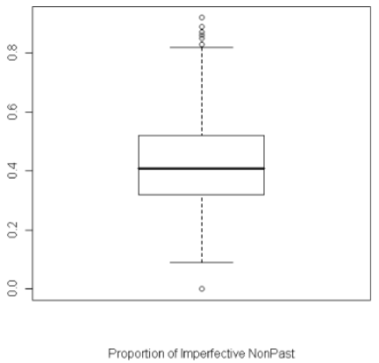
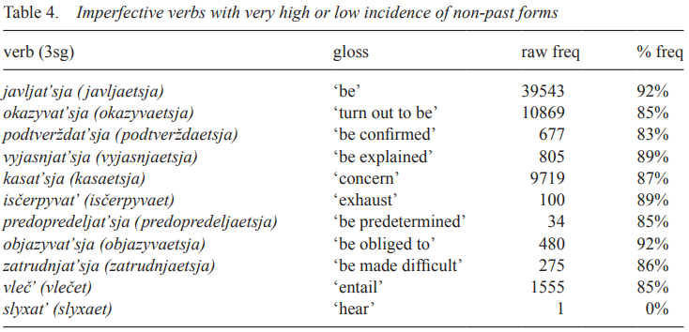
Contrary to the traditional assumption that Imperfective non-past (≈ present) tense expresses actions ongoing at the moment of speaking, the verbs most attracted to this TAM combination express gnomic (timeless) states and facts.
[One example out of the 8 TAM combinations]

Slide 26
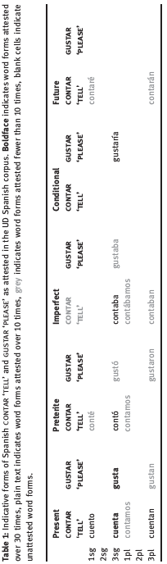
Janda & Tyers 2018/2021: Less is more: why all paradigms are defective, and why that is a good thing
“Native speakers of languages with complex inflectional morphology routinely recognize and produce forms that they have never heard or seen (the “Paradigm Cell Filling Problem”, cf. Ackerman et al. 2009). How is this possible? We take a learning perspective on this question and present evidence to show that inflectional morphology can be mastered through partially overlapping portions of paradigms in input.”

Slide 27
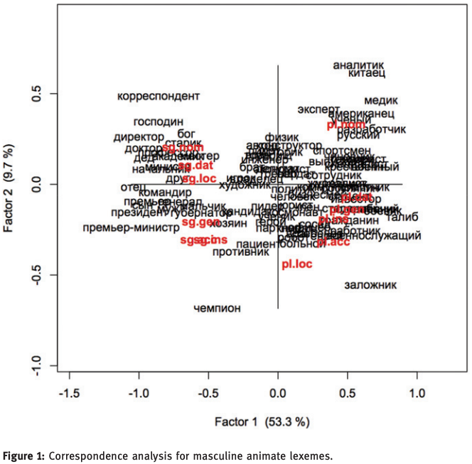

Slide 28

https://korpus.cz/gramatikat/
Proof-of-concept for grammatical profiling at scale
Based on Czech SYN2015 and SYN2020, two representative reference corpora totaling 200M words
Grammatical profiles for all lemmas attested 100 or more times in the composite corpus belonging to the three major parts of speech: nouns, verbs, and adjectives.
Whereas the frequencies of inflected forms are in principle available in digital corpora, baseline grammatical profiles for an entire lexicon are “impossible to acquire … from a standard corpus interface such as KonText, AntConc, or SketchEngine, at least not without enormous effort” (Kováříková et al. 2023).

Slide 29
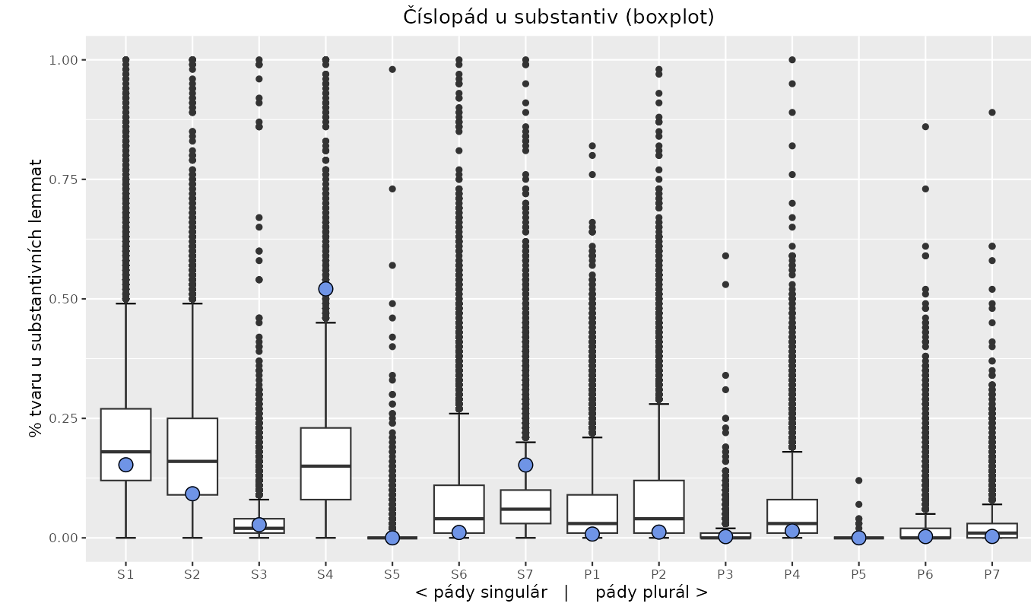
Grammatical profile of radost ‘joy’ (blue dots) vs. distribution for nouns attested ≥ 100 in SYNv11 corpus
Cases: 1 = Nominative, 2 = Genitive, 3 = Dative, 4 = Accusative, 5 = Vocative, 6 = Locative, 7 = Instrumental

Slide 30
Data and analysis of Czech emotion words

Slide 31
Czech data and analysis
Grammatical profiles from GramatiKat
78 nouns (frequency > 1000) describing emotions
Plural removed since all nouns in the list have over 90% of uses in Singular and most have 100% Singular.
Vocative Singular removed since it had zero value for most nouns. There is one noun with more than 1% use in VocSg: láska ‘love’ (3.1%). Second largest: pýcha ‘pride’ 0.3%.
Correspondence analysis of grammatical profiles

Slide 32
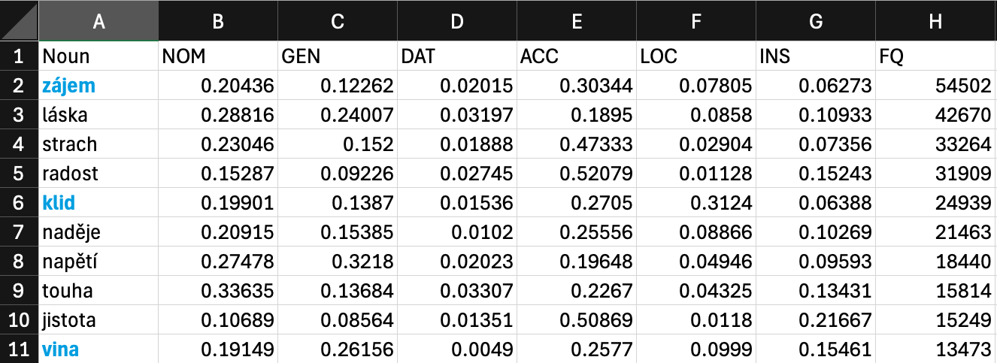
What the data looks like

Slide 33
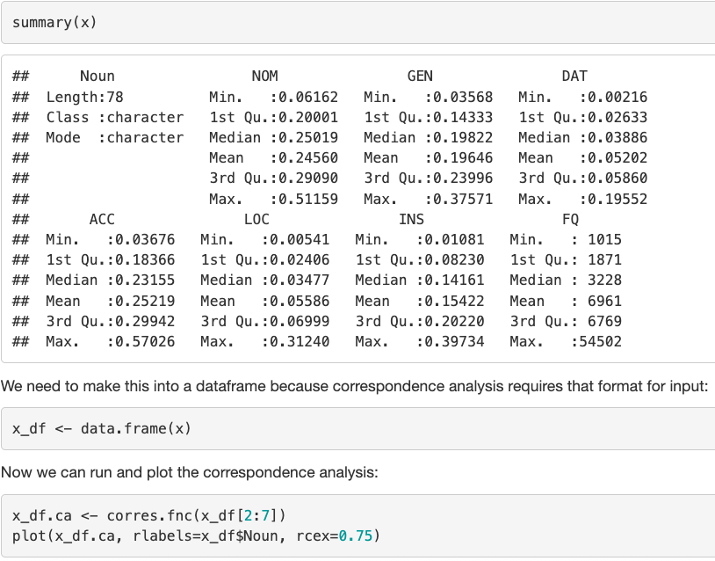
Data distribution and code

Slide 34
metaphorical
possessions
Some words are strongly attracted to certain grammatical cases, where they serve as metaphorical possessions, containers, agents, or accessories
metaphoricalcontainers
metaphorical agents, accessories

Slide 35
metaphorical
possessions
(with English glosses)
Some words are strongly attracted to certain grammatical cases, where they serve as metaphorical possessions, containers, agents, or accessories
metaphoricalcontainers
metaphorical agents, accessories

Slide 36
‘HAPPINESS’
radost
nadšení
euforie
extáze

Slide 37
‘FEAR’
strach
hrůza
panika
nebezpečí
děs
hysterie

Slide 38
‘TENSION’
napětí
úzkost
nervozita
stres

Slide 39
‘DISGUST’
odpor
nechuť

Slide 40
‘LOVE’
láska
vášeň

Slide 41
‘RESPECT’
respekt
úcta
obdiv

Slide 42
‘SURPRISE’
údiv
překvapení
šok

Slide 43
‘ANGER’
hněv
zlost
zloba
zuřivost

Slide 44
‘PRIDE’
hrdost
pýcha

Slide 45
‘SHAME’
hanba
stud

Slide 46
‘SORROW’
žal
smutek
zármutek

Slide 47
klid ‘calm’
šok ‘shock’

Slide 48
odvaha ‘courage’
strach ‘fear’

Slide 49
soucit ‘synmpathy’
odpor ‘repulsion’

Slide 50
úcta ‘respect’
hanba ‘shame’

Slide 51
What does this buy us?

Slide 52
Theoretical contribution
Interaction of lexicon and grammar in production of meaning
In contrast to emotion wheel, mood meter (focus on synonymy/antonymy and intensity), metaphorical understanding of emotions as agents, possessions, accessories, containers
Synonyms can behave very differently, antonyms quite similarly

Slide 53
Lexicography
Improved distinction between apparent synonyms
Improved description of actual use of words

Slide 54
Language pedagogy
Facilitates targeting of most relevant grammatical forms in L2 learning

Slide 55
Works cited
Boas, H. C. 2010. The syntax–lexicon continuum in Construction Grammar. A case study of English communication verbs. Belgian Journal of Linguistics, 24, 54–82.
Bühler, K. 1982. Sprachtheorie. Die Darstellungsfunktion der Sprache. Ungekürzter. Stuttgart & New York: Fischer.
Croft, W. 2001. Radical Construction Grammar. Oxford: Oxford university Press.
Goldberg, A. E. 1995. Constructions: A construction grammar approaches to argument structure. Chicago: Chicago University Press.
Goldberg, A. E. 2006. Constructions at work: The nature of generalization in language. Oxford: Oxford University Press.
Langacker, R.W. 2008. Cognitive Grammar: A Basic Introduction. Oxford: Oxford Univeristy Press.

